Slide 1

GPS Security

Slide 2
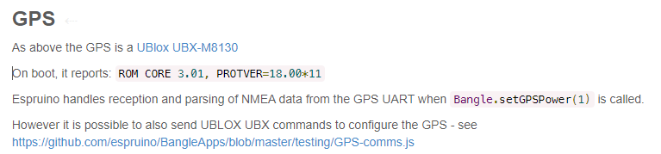
Banglejs GPS module
Source : https://www.espruino.com/Bangle.js+Technical#gps

Slide 3
Ublox M8 & FW 3.01
Security features ingebouwd in de firmware
anti-spoofing
message integrity protection (MITM)
detects and suppresses jamming
Source: https://www.u-blox.com/en/press-releases/u-blox-m8-multi-gnss-receivers-achieve-higher-level-performance-embedded-security

Slide 4

BLE Security

Slide 5
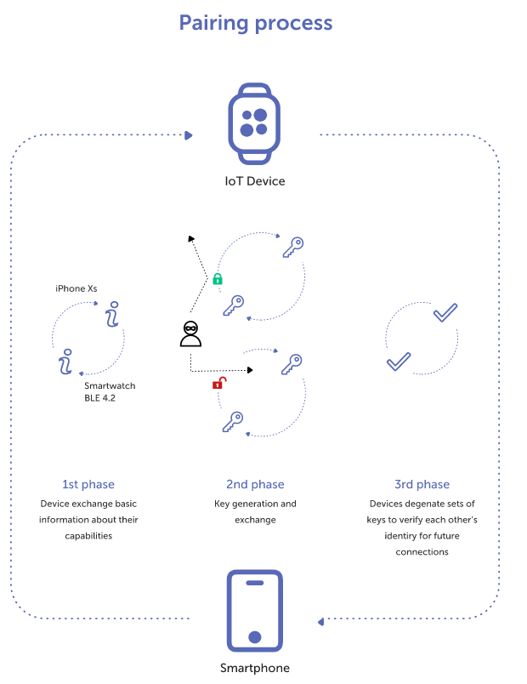
Pairing
Source: https://dzone.com/articles/how-secure-is-the-ble-communication-standard

Slide 6
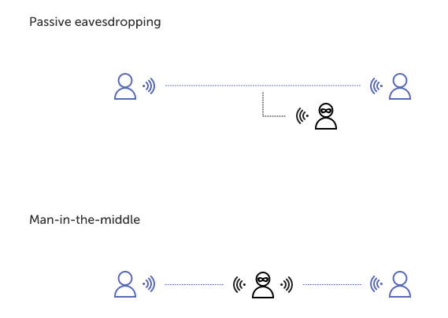
Attacks
Source: https://dzone.com/articles/how-secure-is-the-ble-communication-standard

Slide 7
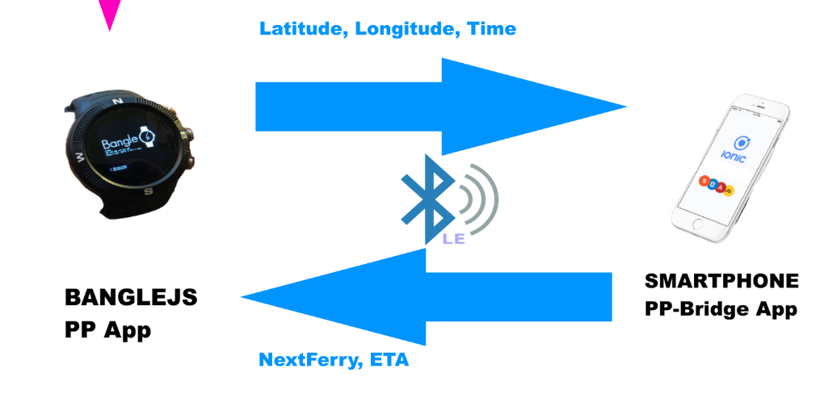

Slide 8

Database Security

Slide 9
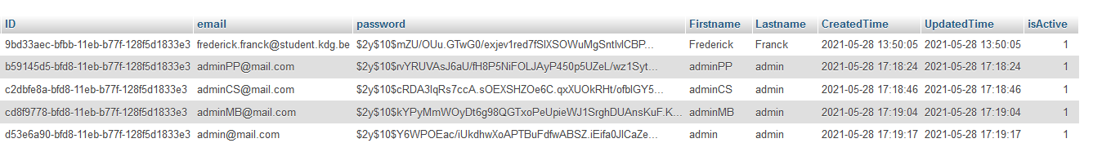
Hashing Passwoorden

Slide 10
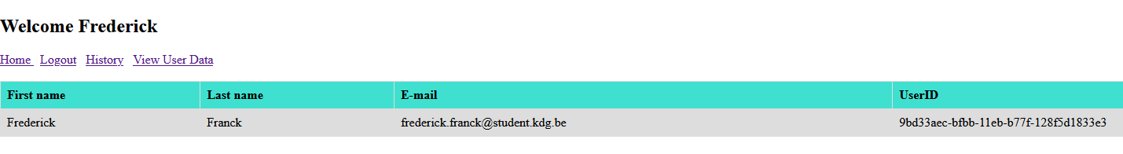
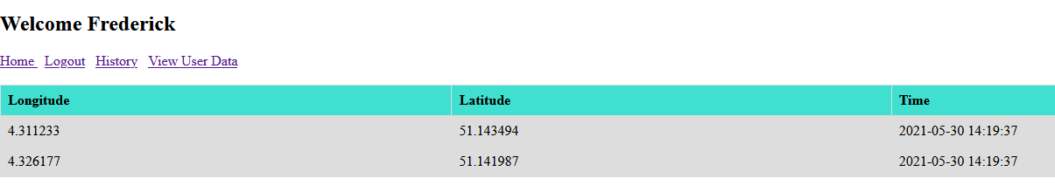
Gebruikers hebben alleen toegang tot hun eigen data

